Slide 1




HTTP Protocol
HTML Forms, HTTP Request
& HTTP Response
C# Web Dev Basics
SoftUni Team
Technical Trainers
Software University
http://softuni.bg

Slide 2




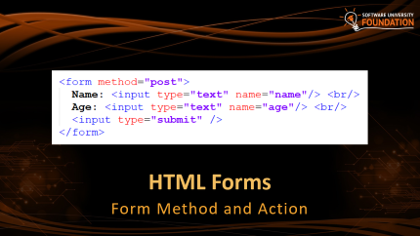







Table of Contents

Slide 3
Have a Question?
sli.do #csharp-web

Slide 4

HTTP Basics
Request and Responses

Slide 5



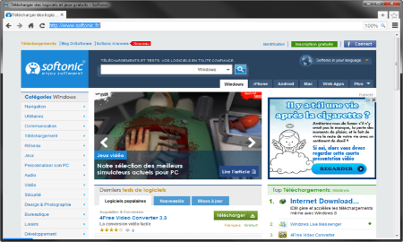





Web Server Work Model
Web Client
Web Server
Technology
Request
Response
Web Resources
Database
HTML, PDF, JPG…

Slide 6

Web Server Work Model
Web Client
Web Server
Technology
Request
.NET Core
Response
Web Resources
Database
HTML, PDF, JPG…

Slide 7


Hyper Text Transfer Protocol
Request
Response
HTTP
HTTP
TCP
TCP
IP
IP
Ethernet
Media (wires / air / fiber)
Ethernet
Notes:
HTTP == Hyper Text Transfer Protocol
Client-server protocol for transferring Web resources (HTML files, images, styles, scripts, data, etc.)
The widespread protocol for Internet communication today
Request-response model (client requests, server answers)
Text-based format (human readable)
Relies on unique resource URLs
Provides resource metadata (e.g. encoding)
Stateless (cookies and Web storages can overcome this)

Slide 8
HTTP Request Methods
HTTP defines methods to indicate the desired action to be performed on the identified resource
Method | Description
GET | Retrieve / load a resource
POST | Create / store a resource
PUT | Update a resource
DELETE | Remove a resource

Slide 9
HTTP Conversation: Example
GET /courses/javascript HTTP/1.1
Host: www.softuni.bg
User-Agent: Mozilla/5.0
<CRLF>
HTTP request:
HTTP response:
The empty line denotes the end of the request header
HTTP/1.1 200 OK
Date: Mon, 5 Jul 2010 13:09:03 GMT
Server: Microsoft-HTTPAPI/2.0
Last-Modified: Mon, 12 Jul 2014 15:33:23 GMT
Content-Length: 54
<CRLF>
<html><title>Hello</title>
Welcome to our site</html>
The empty line denotes the end of the response header

Slide 10

Dev Tools
Tools for Developers

Slide 11
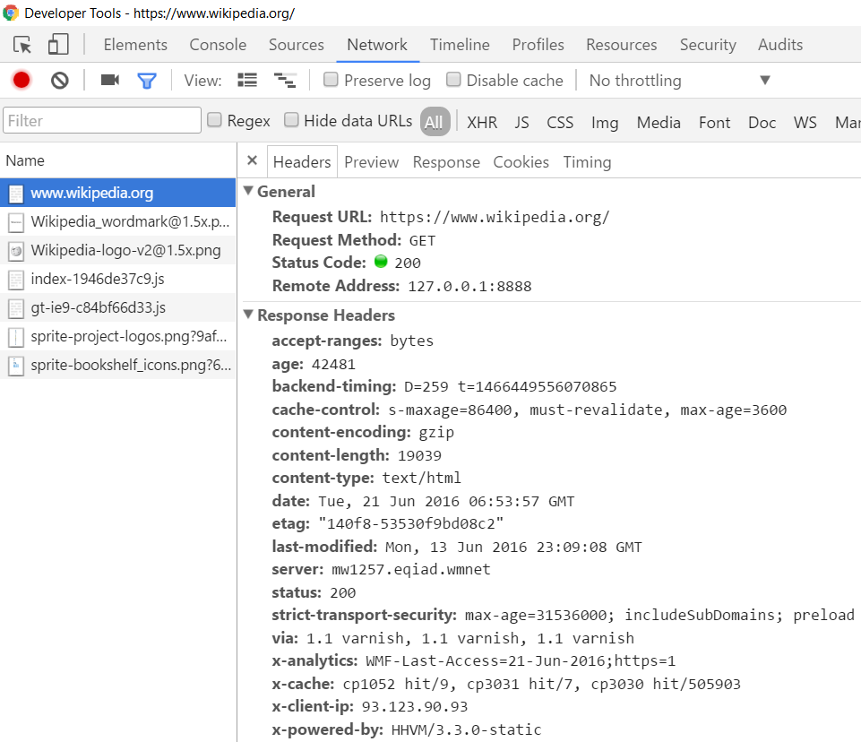
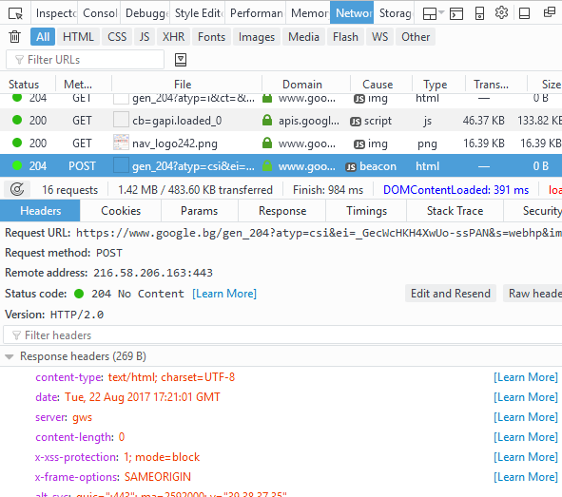
Tools for Developers – Browser Dev Tools
Chrome Developer Tools
Mozilla Developer Tools

Slide 12

Tools for Developers – Browser Add-ons
</>
Postman - Chrome
Rested - Firefox

Slide 13

HTTP Tools for Developers - Desktop
Fiddler
Postman

Slide 14
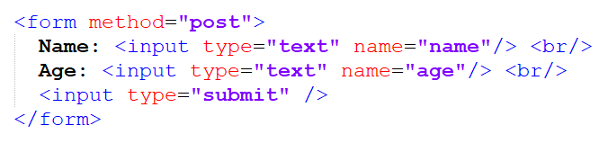
HTML Forms
Form Method and Action

Slide 15
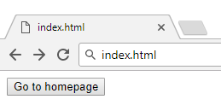

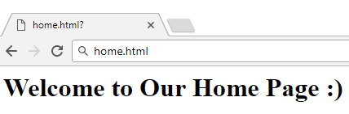

HTML Forms - Action Attribute
Defines where to submit the form data:
Relative URL to the current file
<form action="home.html">
<input type="submit" value="Go to homepage"/>
</form>

Slide 16
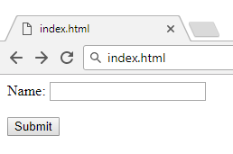

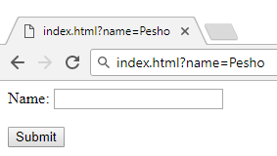

HTML Forms – Method Attribute
Specifies the HTTP method to use when sending form data
<form method="get"> Name: <input type="text" name="name"> <br /><br />
<input type="submit" value="Submit">
</form>
The form data is in the URL

Slide 17
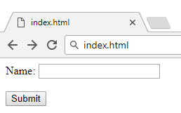

HTML Forms – Method Attribute (2)
<form method="post"> Name: <input type="text" name="name"> <br /><br />
<input type="submit" value="Submit">
</form>
Headers will be explained later
POST http://localhost/index.html HTTP/1.1
Host: localhost
Content-Type: application/x-www-form-urlencoded
Content-Length: 10
name=Pesho
HTTP request body holds the request form data and the response data

Slide 18
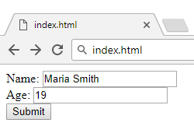
URL Encoded Form Data – Example
<form method="post">
Name: <input type="text" name="name"/> <br/>
Age: <input type="text" name="age"/> <br/>
<input type="submit" />
</form>
POST http://localhost/cgi-bin/index.cgi HTTP/1.1
Host: localhost
Content-Type: application/x-www-form-urlencoded
Content-Length: 23
name=Maria+Smith&age=19
File uploads are not supported

Slide 19

URL
Uniform Resource Locator

Slide 20
Uniform Resource Locator (URL)
http://mysite.com:8080/demo/index.php?id=27&lang=en#lectures
Protocol
Host
Port
Path
Query String
Fragment
URL is a formatted string, consisting of:
Protocol for communicating (http, ftp, https...) – HTTP in most cases
Host or IP address (www.softuni.bg, gmail.com, 127.0.0.1, web)
Port (the default port is 80) – a number in range [0…65535]
Path (/forum, /path/index.php)
Query string (?id=27&lang=en)
Fragment (#lectures) – used on the client to navigate to some section

Slide 21
Query String in C#
Query string contains data that is not part of the path structure
Commonly used in searches and dynamic pages
It is the part of a URL following a question mark (?)
Multiple parameters are separated by some delimiter
http://example.com/path/to/page?name=ferret&color=purple

Slide 22
URL Encoding
URLs are encoded according RFC 1738:
Unreserved URL characters – have no special meaning
Reserved URL characters – can have a special meaning in the URL
Reserved characters are escaped by percent encoding
Space is encoded as "+" or "%20"
[0-9a-zA-Z]
! * ' ( ) ; : @ & = + $ / , ? # [ ]
%[character hex code]

Slide 23
URL Encoding - Examples
All other characters are escaped by %
Char | URL Encoding
space | %20
щ | %D1%89
" | %22
# | %23
$ | %24
% | %25
& | %26
Each character is converted to its ASCII value, represented as hexadecimal digits
Наков-爱-SoftUni
%D0%9D%D0%B0%D0%BA%D0%BE%D0%B2-%E7%88%B1-SoftUni

Slide 24
Valid and Invalid URLs – Examples
Some valid URLs:
Some invalid URLs:
http://www.google.bg/search?sourceid=navclient&ie=UTF-8&rlz=1T4GGLL_enBG369BG369&q=http+get+vs+post
http://bg.wikipedia.org/wiki/%D0%A1%D0%BE%D1%84%D1%82%D1%83%D0%B5%D1%80%D0%BD%D0%B0_%D0%B0%D0%BA%D0%B0%D0%B4%D0%B5%D0%BC%D0%B8%D1%8F
Should be: C%23+.NET+4.0
http://www.google.bg/search?&q=C# .NET 4.0
Should be: %D0%B1 %D0%B8%D1%80%D0%B0
http://www.google.bg/search?&q=бира

Slide 25

MIME and Media Types
Multi-Purpose Internet Mail Extensions

Slide 26
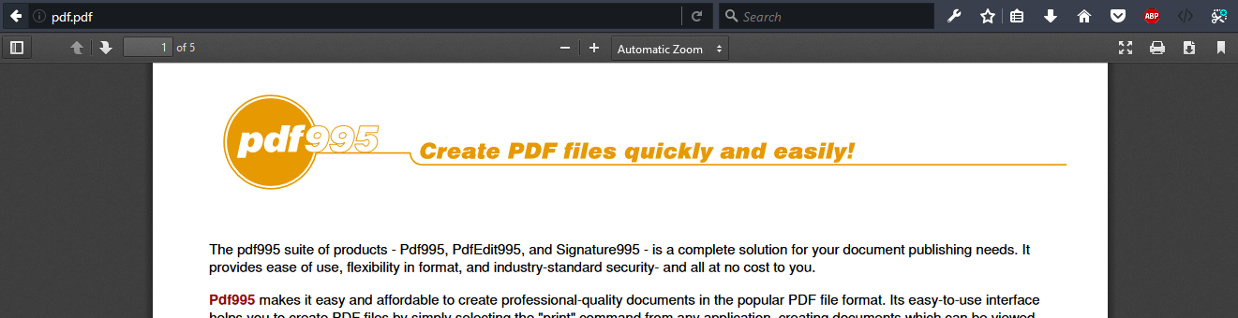
What is MIME?
MIME == Multi-Purpose Internet Mail Extensions
Internet standard for encoding resources
Originally developed for email attachments
Used in many Internet protocols like HTTP and SMTP

Slide 27
Concepts of MIME
Content-Type - media type of the message content
text/html, image/gif, application/pdf
Content-Disposition - specifies the presentation style
attachment; filename=logo.jpg
Multipart messages - multiple resources in a single document

Slide 28
Common MIME Media Types
MIME Type / Subtype | Description
application/json | JSON data
image/png | PNG image
image/gif | GIF image
text/html | HTML
text/plain | Text
text/xml | XML
video/mp4 | MP4 video
application/pdf | PDF document

Slide 29

HTTP Request
What is a HTTP Request?

Slide 30
HTTP Request Message
Request message sent by a client consists of:
HTTP request line
Request method (GET / POST / PUT / DELETE / …)
Resource URI (URL)
Protocol version
HTTP request headers
Additional parameters
HTTP request body – optional data, e.g. posted form fields
<method> <resource> HTTP/<version>
<headers>
(empty line)
<body>

Slide 31
GET Request Method – Example
<form method="get">
Name: <input type="text" name="name" />
Age: <input type="text" name="age" />
<input type="submit" />
</form>
HTTP request line
GET /HTTP/1.1
Host: localhost
<CRLF>
HTTP request headers
The request body is empty

Slide 32
POST Request Method – Example
The POST method transfers data in the HTTP body
POST can send text and binary data e.g. upload files
HTTP request line
POST /login HTTP/1.1
Host: localhost
Content-Length: 59
<CRLF>
username=mente&password=top*secret!
<CRLF>
HTTP request headers
The request body holds the submitted form data

Slide 33

HTTP Response
What is a HTTP Response?

Slide 34
HTTP Response Message
The response message sent by the HTTP server consists of:
HTTP response status line
Protocol version
Status code
Status text
Response headers
Provide meta data about the returned resource
Response body
The content of the HTTP response (data)
HTTP/<version> <status code> <status text>
<headers>
<CRLF>
<response body – the requested resource>

Slide 35
HTTP Response – Example
Example of HTTP response from the Web server:
HTTP response status line
HTTP/1.1 200 OK
Date: Fri, 17 Jul 2010 16:09:18 GMT+2
Server: Apache/2.2.14 (Linux)
Accept-Ranges: bytes
Content-Length: 84
Content-Type: text/html
<CRLF>
<html>
<head><title>Test</title></head>
<body>Test HTML page.</body>
</html>
HTTP response headers
HTTP response body

Slide 36
HTTP Response Codes
HTTP response code classes
1xx: informational (e.g., "100 Continue")
2xx: successful (e.g., "200 OK", "201 Created")
3xx: redirection (e.g., "304 Not Modified", "301 Moved Permanently", "302 Found")
4xx: client error (e.g., "400 Bad Request", "404 Not Found", "401 Unauthorized", "409 Conflict")
5xx: server error (e.g., "500 Internal Server Error", "503 Service Unavailable")

Slide 37
HTTP Response – Example
Example of HTTP response with error result:
HTTP response status line
HTTP/1.1 404 Not Found
Date: Fri, 17 Nov 2014 16:09:18 GMT+2
Server: Apache/2.2.14 (Linux)
Connection: close
Content-Type: text/html
<CRLF>
<HTML><HEAD><TITLE>404 Not Found</TITLE></HEAD>
<BODY>
<H1>Not Found</H1>
The requested URL /img/logo.gif was not found on this server.<P> <HR><ADDRESS>Apache/2.2.14 Server at Port 80</ADDRESS>
</BODY></HTML>
HTTP response headers
The HTTP
response body

Slide 38
Browser Redirection
HTTP GET requesting a moved URL:
The following HTTP response (301 Moved Permanently) tells the browser to request another URL:
GET / HTTP/1.1
Host: http://softuni.org
User-Agent: Gecko/20100115 Firefox/3.6
<CRLF>
HTTP/1.1 301 Moved Permanently
Location: http://softuni.bg
…

Slide 39
Content-Type and Disposition
With Content-Type response header the server specifies how the output should be processed
Examples:
UTF-8 encoded HTML page. Will be shown in the browser.
Content-Type: text/html; charset=utf-8
Content-Type: application/pdf
Content-Disposition: attachment; filename="Report-April-2016.pdf"
This will download a PDF file named Report-April-2016.pdf

Slide 40
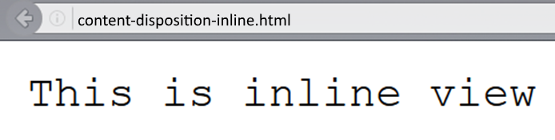
Content-Disposition – Example
Content-Type: text/plain
Content-Length: 19
Content-Disposition: inline filename=example.txt

Slide 41
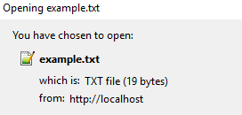
Content-Disposition – Example (3)
Content-Type: text/plain
Content-Length: 19
Content-Disposition: attachment; filename=example.txt

Slide 42

Summary
HTML forms can send 2 types of HTTP requests: GET and POST
HTTP works with message pairs called HTTP request and HTTP response
HTTP headers describe the request / response metadata
See the most used headers here
The URL parts define:
protocol, host, port, path, query string, and fragment

Slide 43







C# Web Dev Basics – HTTP Protocol
https://softuni.bg/courses/java-web-development-basics

Slide 44






SoftUni Diamond Partners

Slide 45






SoftUni Diamond Partners

Slide 46
License
This course (slides, examples, demos, videos, homework, etc.) is licensed under the "Creative Commons Attribution-NonCommercial-ShareAlike 4.0 International" license

Slide 47





Trainings @ Software University (SoftUni)
Software University – High-Quality Education, Profession and Job for Software Developers
softuni.bg
Software University Foundation
http://softuni.foundation/
Software University @ Facebook
facebook.com/SoftwareUniversity
Software University Forums
forum.softuni.bg

